Slide 1
Identifying Exoplanets
Sean Kendall

Slide 2
Background
What is an exoplanet?
Planet orbiting another star than our Sun
How do you detect exoplanets?
Two main methods:
Radial Velocity
Gravity of the planet pulling on the star that it orbits causes the star to wobble a bit as the planet travels around the star
Transit
Planet blocks a bit of the light from the star as it travels between our telescope and the star, making the star appear a bit dimmer
Both methods favor larger planets (planets with a larger radius)

Slide 3
Background
Could be detecting interference from other stellar bodies or defects in our telescope
How to confirm an object is an exoplanet?
Multiple transits of the object in question
Provides a regular pattern and more data that can be used to confirm the object as a planet
Favors faster planets (planets with shorter years
Confirmation from multiple telescopes or with multiple detection methods

Slide 4
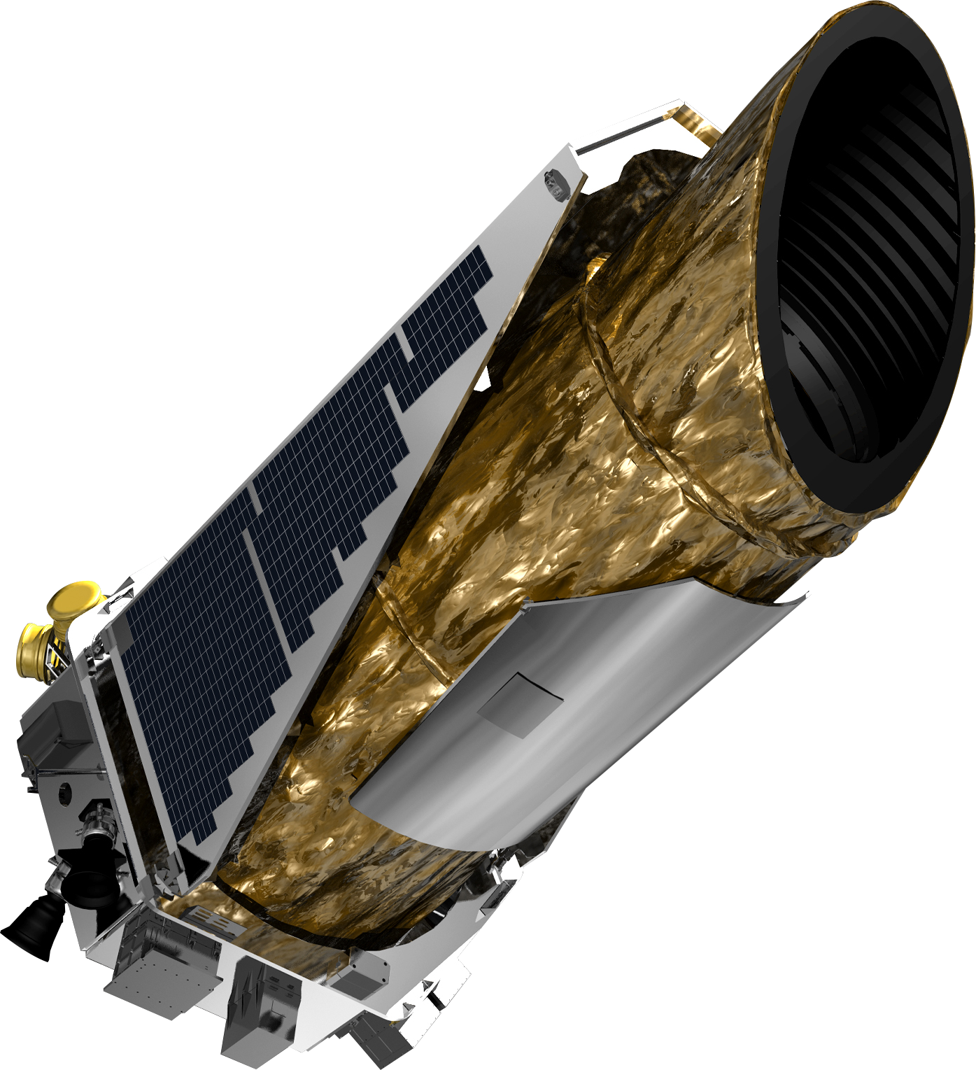
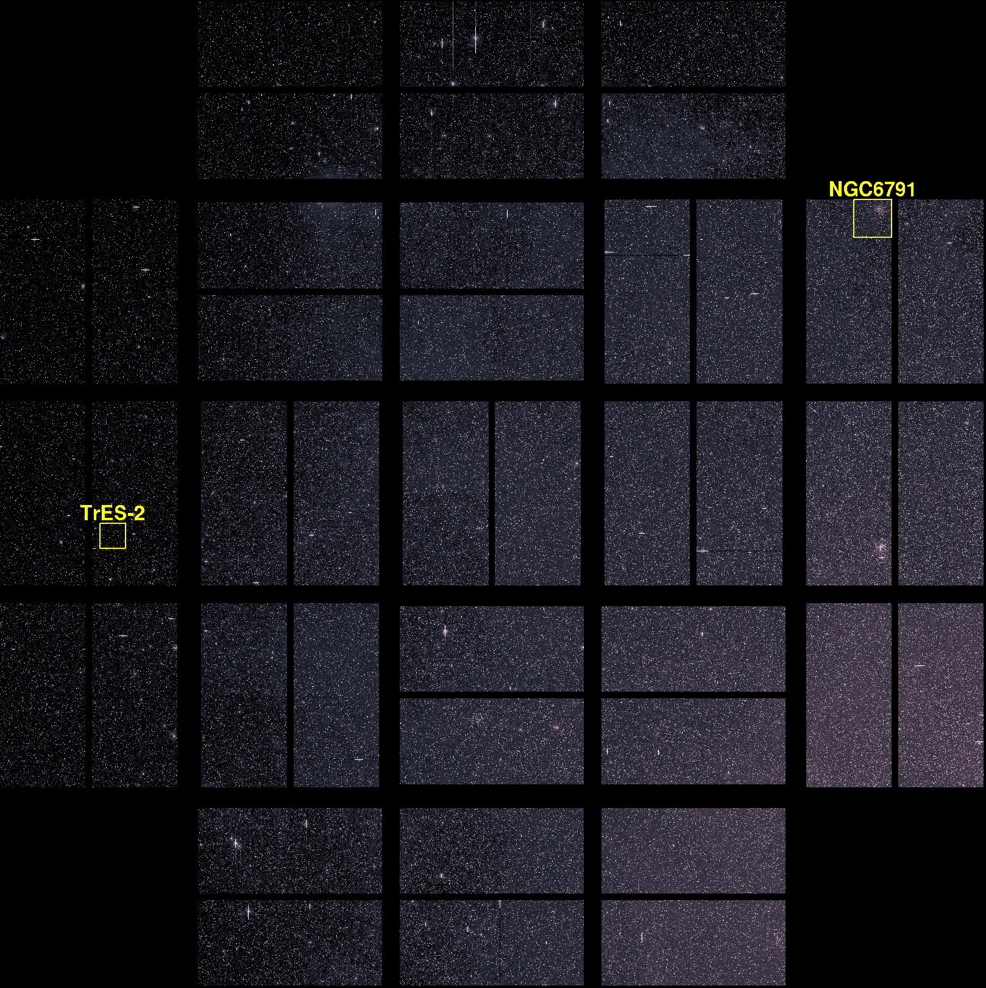
K2 Survey Data
Survey done by the Kepler Space Telescope in its extended mission from 2014-2018
Table includes 2582 objects
371 confirmed as planets
1974 objects which are potentially planets
Use 300 planets as the sample size

Slide 5
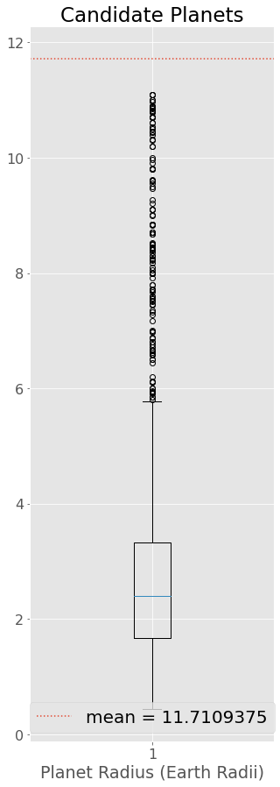
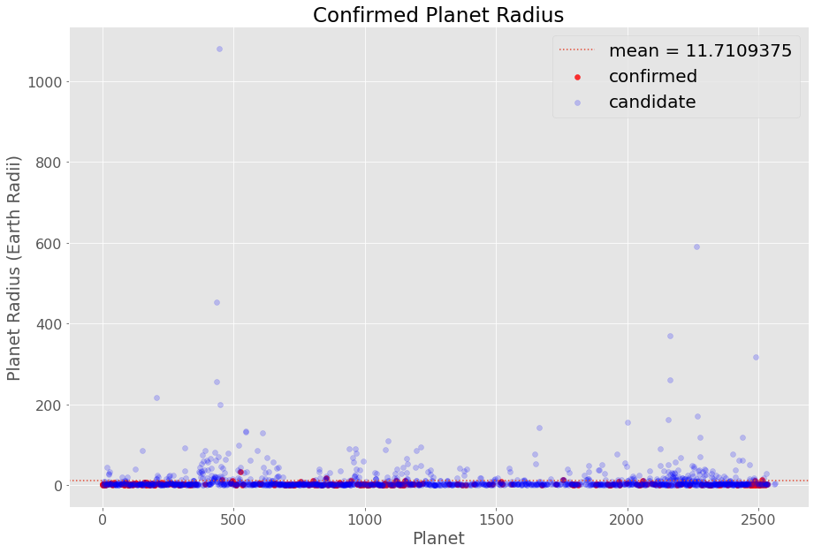
Outliers
Large candidate planet outliers – planet with a 83,830-day year and planet with a radius of 1,080 Earth radii
Filter planets with years <= 1 Earth year (365 days) and <= Jupiter radius (11.2 Earth radii)

Slide 6
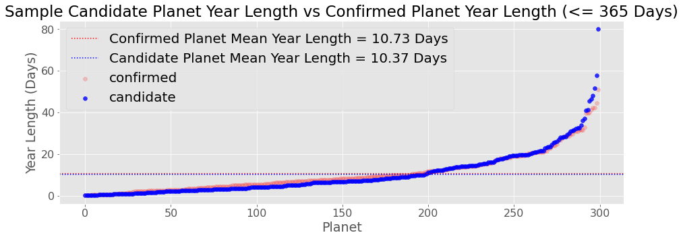
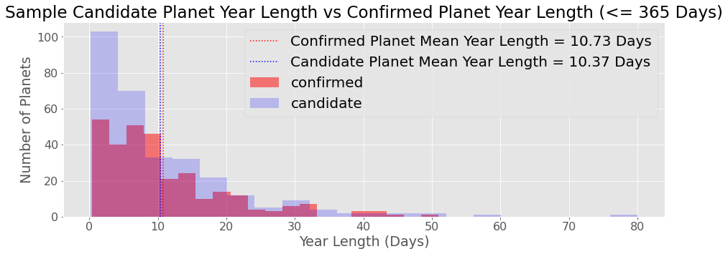
Sample Planet Years

Slide 7
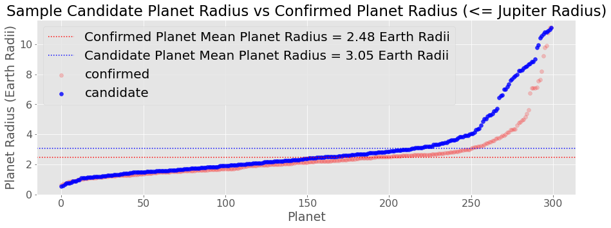
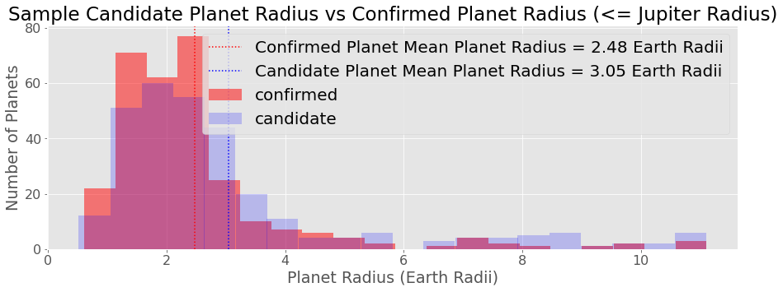
Sample Planet Radii

Slide 8
Patterns
Correlation between confirmed planet and candidate planet distributions

Slide 9
Works Cited
Be sure to include print and electronic sources and put them in alphabetical order.

